Slide 1
Design Engineering
Session 11 - 12
Course : COMP6100/Software Engineering
Effective Period : Desember 2017

Slide 2
These slides have been adapted from
Osterwalder, Alexander et al. 2010. Business Model Generation: A Handbook for Visionaries, Game Changers, and Challengers. JWS. New Jersey. ISBN: 978-0470-87641-1. Chapter 4.
Acknowledgement

Slide 3
LO 2 : Analyze the potential business project using business model framework
Learning Objectives

Slide 4
Contents
What makes a good design ?
Factors affecting design performance
The design process 1 – Recognition of the problem to be solved
The design process 2 – Creative phase
The design process 3 - Implementation

Slide 5

What so good about this product?

Slide 6
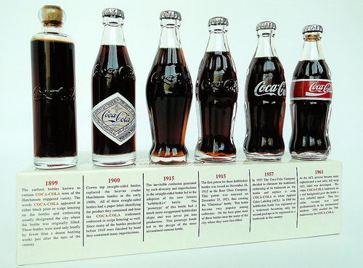

What makes a good design ?
Alternatively –
How can we assess these designs ?
The Design Process

Slide 7
What makes a good design ?
Fit for purpose
Cost effective
Successful ?
Iconic
Long lasting
Does the job its design for in the most effective, efficient manner.

Slide 8

Factors affecting design performance
Cost effective
Satisfies service requirements
Can be made – achievable
Like this ?

Slide 9

The Design Process
A methodology which requires a logical, sequential analysis of the design problem to be solved.
Set out in stages which helps us to progressively develop a solution to the problem set.
The best solution given the
Technology available at the
Time.

Slide 10
The Design Process 1
Recognition of the problem to be solved
BRIEF
    Recognition of problem
    Identification of needs
    Recognition of situation
INVESTIGATION
    Research in topic – what exists already
    Collation of relevant information
    Analysis of topic
    Specification of requirements

Slide 11
The design process 2 – Creative phase
IDEAS
  Generation of realistic ideas to satisfy product design brief and functional requirements
EVALUATION
  Evaluation of ideas against the specification
  Identification of proposed solution
DEVELOPING
  Sketching, modeling refining proposed solutions

Slide 12

The design process 3 – Implementation
PLANNING
  Drawings from which the product can be realized
  Parts list, planning sheets for realization
Manufacture
  Make the product to design
  Evaluate in the field
Revisit the original design
– Good designs ‘evolve’ over time

Slide 13
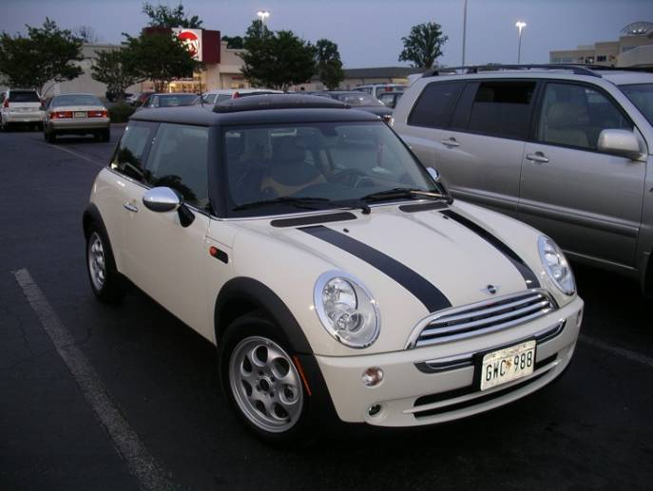
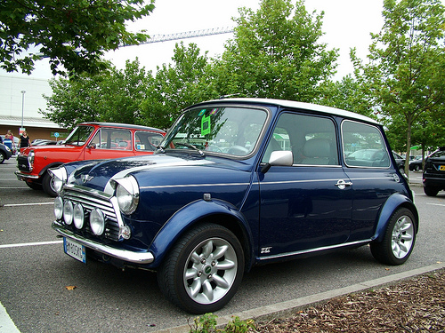
The Design Process
In reality we produce products which satisfy an immediate need as the customer wants it yesterday.
Major innovation in design and manufacture require us to look into new materials, manufacturing technologies and potential markets to ‘look into the Future

Slide 14

The Design Process
Analysis of the Design

Slide 15
The Design Process
In engineering we use the design process to provide solutions to problems – by applying a logical set of stages. In reality these are usually reduced in length because of;
Previous experience / knowledge
Custom and practice
What the competition are doing

Slide 16
References
Alexander Osterwalder & Yves Pigneur, Business Model Generation, John Willey & Sons. Inc. Hoboken, New Jersey, United States of America, 2010, ISBN: 978-0470-8764-1 (BMG)
Schaper, Michael.(2011). Entrepreneurship and Small Business 3-rd Asia-Pasific Edition. John Wiley & Sons Autralia, Ltd. Milton. ISBN: 978-1-74216-462-5. (ESB)

Slide 17
Q & A

